Slide 1
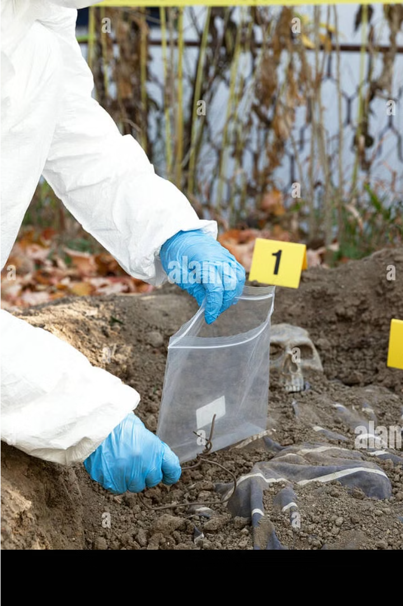

Introduction to Forensics Evidence Preparation
Properly preparing forensic evidence is crucial for effective courtroom testimony. This introduction covers the key steps to ensure evidence is handled, documented, and presented properly to maximize its impact and credibility.

Slide 2
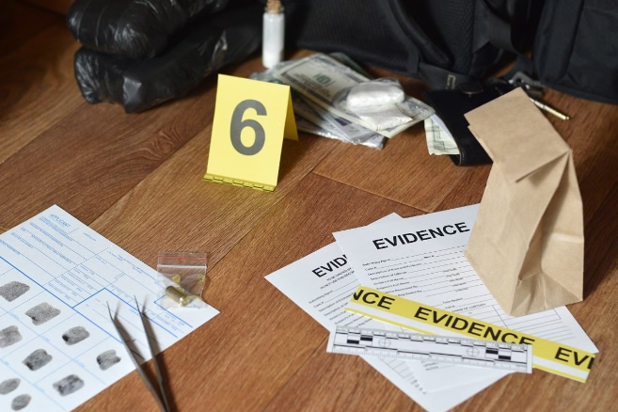
Importance of Proper Evidence Handling
Proper evidence handling is crucial in forensic investigations. It ensures the integrity and admissibility of evidence in court. Mishandling can compromise the chain of custody, leading to evidence tampering allegations and compromising the case.
Detailed protocols must be followed at every stage, from collection to storage and transportation, to maintain the evidence's pristine condition and traceability.

Slide 3
Chain of Custody Protocols
Documenting Evidence Transfers
Tamper-Evident Packaging
Secure Storage
Continuous Monitoring
Evidence must be stored in a secure, limited-access facility to prevent tampering or loss. Access should be restricted and logged to maintain the chain of custody.
Evidence must be packaged in tamper-evident containers like sealed bags or boxes. This ensures the integrity of the evidence and allows any unauthorized access to be detected.
The location, status, and handling of evidence must be continuously monitored and documented throughout the entire process, from collection to presentation in court.
Maintaining a comprehensive chain of custody record is crucial. Each time evidence is transferred between individuals or locations, the transfer must be carefully documented with details like the date, time, names, and signatures of those involved.

Slide 4
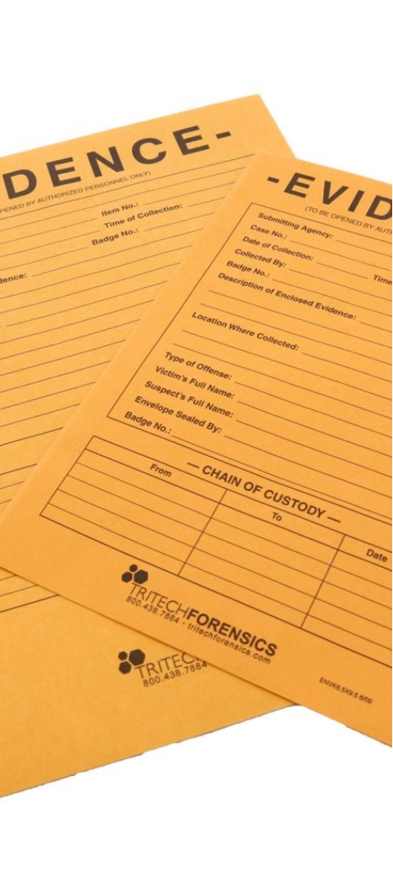



Documentation and Labeling Procedures
Detailed Records
Maintain thorough documentation of each step in the evidence collection and handling process, including date, time, location, and personnel involved.
Unique Identifiers
Assign a unique case number and label each piece of evidence with a distinct identification code to ensure traceability.
Chain of Custody
Record the transfer of evidence between individuals, including their names, roles, and the date and time of each handoff.

Slide 5
Packaging and Sealing of Evidence
Containment
1
Place evidence in appropriate containers
Labeling
2
Clearly mark containers with details
Security
3
Seal containers to prevent tampering
Proper packaging and sealing of forensic evidence is crucial to maintain the integrity and admissibility of the samples. Each item must be placed in a suitable container, labeled with relevant case information, and securely sealed to establish a clear chain of custody. This careful handling ensures the evidence can be reliably presented in court.

Slide 6
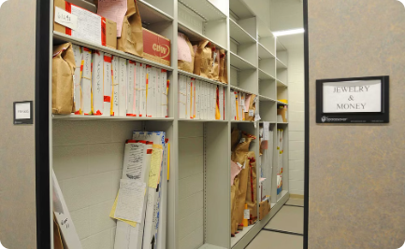
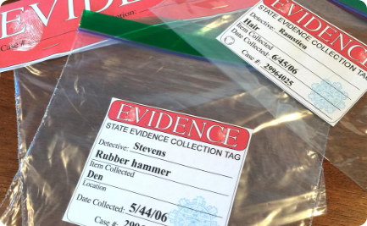
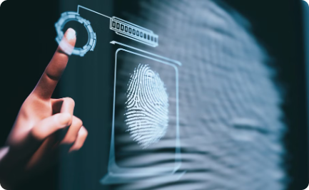
Preservation and Storage of Evidence
Controlled Environment
Detailed Cataloging
Secure Storage Facilities
Proper storage of forensic evidence requires a controlled environment to prevent degradation or contamination. Temperature, humidity, and light levels must be carefully monitored and maintained.
Comprehensive documentation and labeling of each piece of evidence is crucial. This ensures a clear chain of custody and facilitates retrieval when needed for examination or courtroom presentation.
Evidence must be stored in secure, access-controlled facilities to prevent tampering or unauthorized access. Strict protocols govern who can access the storage areas and how evidence is logged in and out.

Slide 7
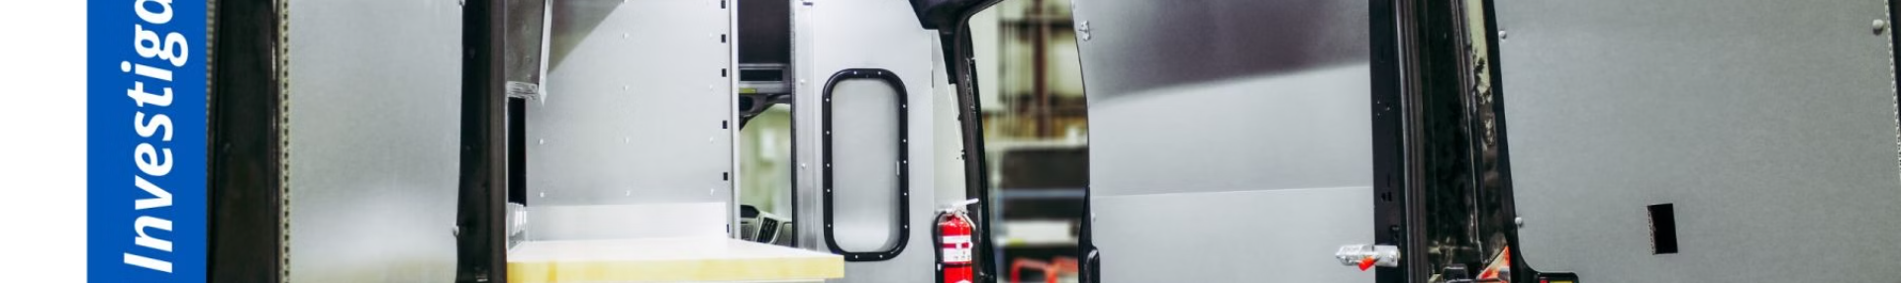
Transportation of Evidence to Lab
Secure Packaging
Ensure all evidence is properly packaged and sealed to prevent contamination or damage during transport. Use tamper-evident seals and sturdy containers.
Timely Delivery
Deliver the evidence to the lab as soon as possible to minimize delays and maintain the integrity of the samples.
1
2
3
Chain of Custody
Carefully document the transfer of evidence, including the date, time, and identity of the individuals involved at each step.

Slide 8

Analysis and Examination of Evidence
After evidence is properly collected and documented, it is carefully transported to a forensic analysis lab. Trained examiners use specialized equipment and techniques to thoroughly analyze the evidence and extract any relevant information or data.
This meticulous process may involve microscopic examination, chemical testing, digital forensics, or other advanced analytical methods depending on the type of evidence. The findings are then meticulously documented to establish the evidentiary value and ensure the integrity of the evidence.

Slide 9

Preparing Evidence for Courtroom Testimony
Organize and Review
Craft Clear Explanations
Visuals and Exhibits
Meticulously review all evidence to ensure accurate documentation, proper labeling, and secure packaging. Organize materials in a logical manner for easy presentation.
Develop high-quality visual aids, such as photos, diagrams, or 3D models, to illustrate key evidence and support your testimony.
Prepare clear, concise explanations of each piece of evidence. Anticipate questions and rehearse responses to communicate complex forensic details effectively.

Slide 10
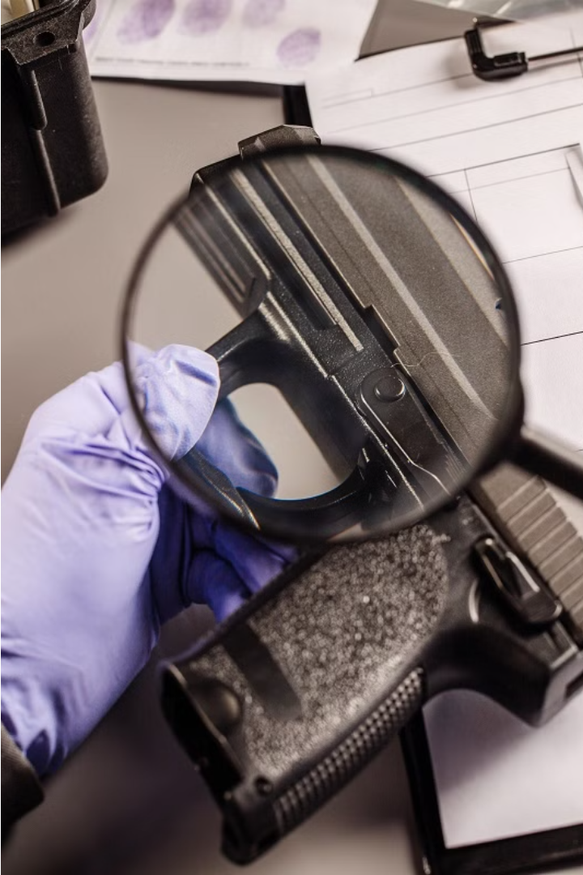
Conclusion and Best Practices
In conclusion, proper handling and preservation of forensic evidence is crucial for ensuring the integrity and admissibility of evidence in court. Following established protocols and best practices helps maintain the chain of custody and safeguard the evidence's evidentiary value.

